Slide 1
Viewability Case Studies
April 2015 – December 2015

Slide 2
Table of contents
Challenges & Solutions – page 3
Methods – page 5
CASE 1 – Changing Layout & Ad Placement – pages 5-8
CASE 2 – Stationary/Floating Ad – pages 9-11
CASE 3 – Stationary/Floating Ad – pages 12-14
CASE 4 – Lazy Loading Ad – pages 15-17
CASE 5 – Mobile Responsive Ad Serving – pages 18-20

Slide 3
challenges & solutions
Challenges:
Publishers are facing the challenge on standard ad sizes, that at least 50% of an ad must be in-view at least 1 second. With new technologies that can measure viewability, the MRC recommends that publishers strive for at least 70% viewability for each campaign.
It would be easy for the publisher to eliminate all ad placements below the recommended threshold, but the impact on inventory could be devastating.
Solutions:
The following case studies will show specific techniques publishers can implement that are proven to increase viewability or maintain high viewability and inventory.
Ad placement or web page layout
Stationary/Floating Ads
Lazy Loading Ad
Mobile Responsive Ad Serving

Slide 4
METHODS
Tools:
Moat & comScore were used to obtain viewability metrics
Both tools are accredited by the MRC, but there are significant discrepancies in viewability metrics between the tools
The point of using two tools is not to get them to agree on the metrics themselves, but getting them to agree that the changes made in each case study resulted in an improvement in viewability metrics in both tools
Date Ranges:
Pre date ranges match post date ranges by length of time and days of the week
Significance:
All % differences were tested for statistical significance

Slide 5

CASE 1 – CHANGING LAYOUT & Ad Placement - Goals
Goal:
Improve viewability by:
Removing ad placements with low viewability
Shifting ad positions to keep ads in-view for longer periods of time
Specific Changes:
At top, moved the 728x90 from the top of the page to beneath the logo, directly above navigation
On right, put a combo ad higher on the page for any sizes within max width of 300 to max height of 600
Removed 728x90 ad at the very bottom of the page
Added a stationary/floating ad to the left side of the page, it will only show if the resolution of the browser allows for it

Slide 6
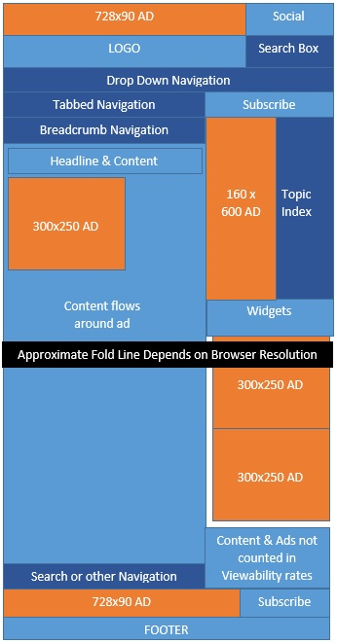
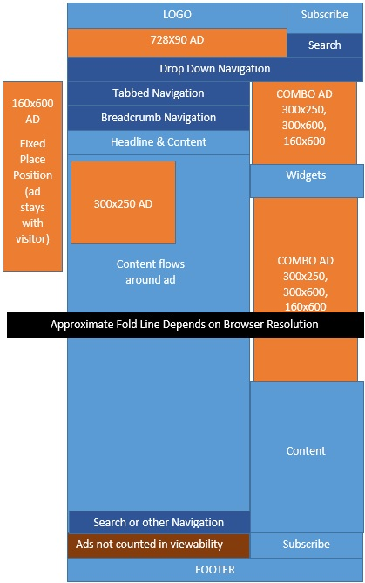
CASE 1 – CHANGING LAYOUT & Ad Placement – Visuals
BEFORE
AFTER
Floating Ad

Slide 7
CASE 1 – CHANGING LAYOUT & Ad Placement – Results
Results for In-View %:
Moat: 101% improvement of In-View % with an increase of 40 percentage points.
comScore: 72% improvement of In-View % with an increase of 25 percentage points.

Slide 8
CASE 1 – CHANGING LAYOUT & Ad Placement – Results
Results for In-View Time:
Moat: 91% improvement of in-view time with an increase of 18 seconds on all viewable ads.
comScore: 3% improvement of in-view time moving to 5+ seconds in-view with a decrease of 10% in the 1-4 second bucket.

Slide 9
CASE 2 – Stationary/floating ad – Goals
Goal:
Improve time an ad remains viewable by:
Keeping the ad in one position and having it follow a person when they scroll down the page
Specific Changes:
Removed all 160x600 ads from all current placements
Added a new placement that floats to the left of the regular body of the page, this placement tracks down the page as the visitor scrolls down the page
If the browser resolution is too small, the ad will not appear, therefore, it won’t be counted in the amount of measureable impressions

Slide 10

CASE 2 – Stationary/floating ad – Visuals
Floating Ad

Slide 11
CASE 2 – Stationary/floating ad – Results
Results:
Moat: 144% improvement for In-View Time with an increase of 38 seconds per ad. This is higher than 91% improvement and 18 second increase of all ads in the first case study, indicating that the stationary ad has a higher time in-view than other ads.
comScore: 29% decrease in visitors who saw the ad between 1-4 seconds and a 5% increase in visitors who saw the ad 5 seconds or more. This is an improvement over the first case study that only saw a 3% push to the 5+ second bucket, indicating that the stationary ad has a higher time in-view than other ads.

Slide 12
CASE 3 – Stationary/floating ad – Goals
Goal:
Improve time an ad remains viewable by:
Keeping the ad in one position and having it follow a person when they scroll down the page
Specific Changes:
Added a new placement that floats to the left of the regular body of the page, this placement tracks down the page as the visitor scrolls down the page
If the browser resolution is too small, the ad will not appear, therefore, it won’t be counted in the amount of measureable impressions

Slide 13
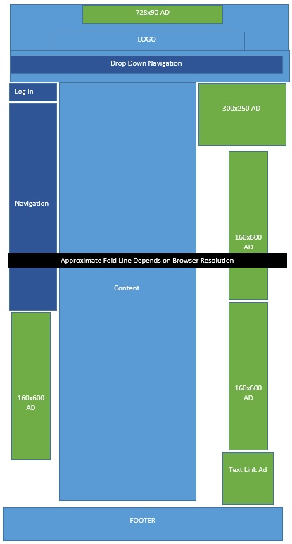
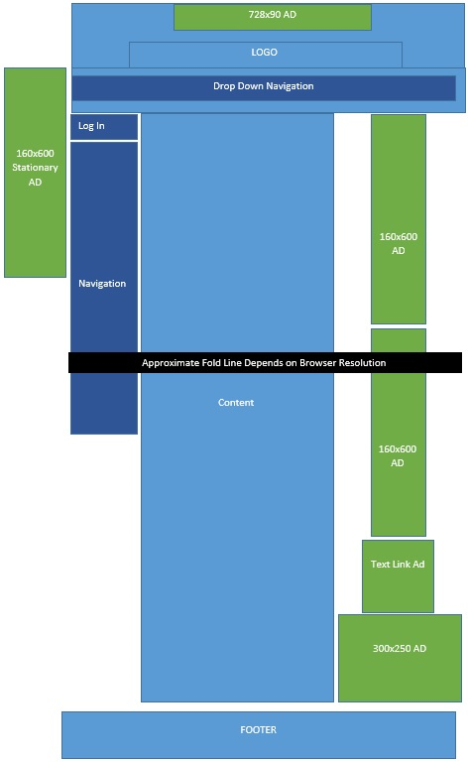
CASE 3 – Stationary/floating ad – Visuals
BEFORE
AFTER
Floating Ad

Slide 14
CASE 3 – Stationary/floating ad – Results
Result metrics from Moat (comScore metrics improved similarly)
Floating Ad Results: 94% in view with 45 seconds in-view time!
Total Results: increase of 25% for viewability and 2% for in-view time.

Slide 15
CASE 4 – Lazy Loading – Goals
Goal:
Improve viewability by:
Adding in placements in a poorly viewed section of the page by using an ad that only loads when someone is actually viewing that part of the page
Specific Changes:
At bottom of the page, replaced a 728x90 placement with a lazy load ad
The ad within this placement is “lazy-loading” it will only come into view when a visitor scrolls to that part of the page.

Slide 16
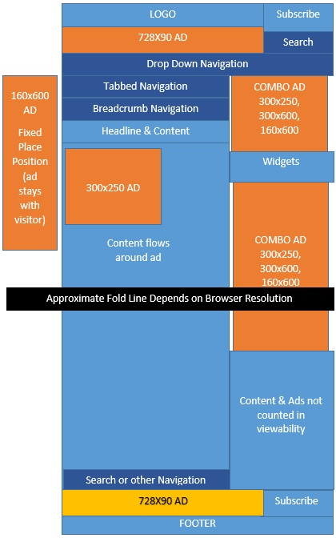
CASE 4 – Lazy Loading – Visuals
BEFORE
AFTER
Lazy Loading Ad

Slide 17
CASE 4 – Lazy Loading – Results
Result Metrics from Moat:
24% increase in viewability
-18% decrease in viewable inventory
In-View time remained the same

Slide 18

CASE 5 – Mobile Responsive - Goals
Goal:
Improve viewability by:
Removing ads that don’t display correctly on mobile devices
Adding in ads that do display correctly on mobile devices
Specific Changes:
Since 160x600 do not get a great viewability on a mobile device, the site makes the 160x600 ad disappear when a person views on mobile
The 728x90 does not appear correctly on the mobile device (unless the creatives are mobile responsive (which in most cases they are not), so the 728x90 now disappears when a person views on mobile
The 300x250 was being pushed all the way to the bottom of the mobile device, it is now programmed to appear at the top of the mobile device (below the logo and navigation).

Slide 19
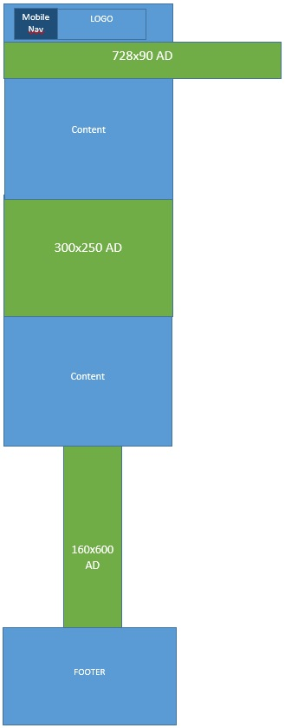
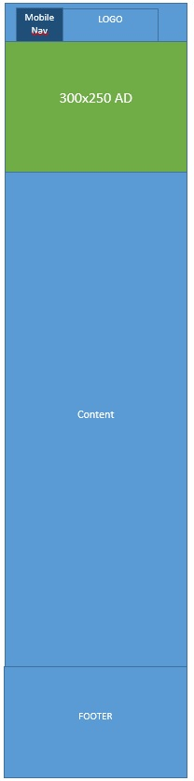
CASE 5 – Mobile Responsive - Visuals
BEFORE
AFTER

Slide 20
CASE 5 – Mobile Responsive - results
Result Metrics from Moat :
106% increase in viewability on mobile devices
In-View time decreased by -33%, however, Moat benchmarks are 15.8 seconds on mobile and 24.8 seconds on desktop. Therefore, both numbers are still well over benchmarks.

